Slide 1

Subject-Verb Agreement

Slide 2
Subject
The subject is the doer of the action. Alternatively, it can be described as who or what the sentence is about. It is important for you to be able to identify the subject in the sentence. Once you have identified the subject, you need to check whether it agrees the verb or not.

Slide 3
Verb
Verbs are words that express an action, state or occurrence. However, not all verbs are action words. Some verbs as: is,am, are was, were, etc. describe the state and not the action.

Slide 4

Subject-verb agreement refers to the relationship between the subject and predicate of the sentence.
Subjects and verbs must always agree in number.

Slide 5

For example:
The light in the lamppost flickers each night.
In this sentence, the subject light is singular; therefore, the verb that describes the action of the subject must also be singular: flickers.
If the subject was plural, the verbs would have to change form to agree with the subject.
For example:
The lights in the lampposts flicker each night.
In this sentence, since the subject is now plural, the -s has to be removed from the verb in order to have subject-verb agreement.

Slide 6
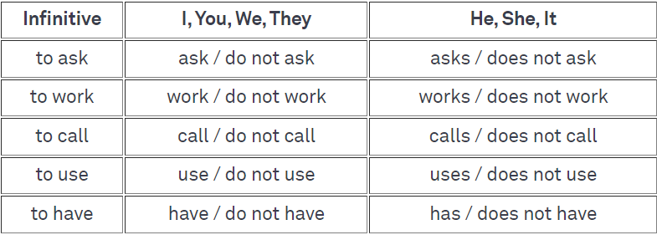
Let’s Learn the basics first:-
In the present tense, verbs agree with their subjects in number (singular/plural) and in person (first, second, or third). The present tense ending –s (or –es) is used on a verb if the subject is third person singular. Otherwise, the verb takes no ending.

Slide 7
Subject–Verb Agreement Rules
1. If the subject is singular, the verb must be singular too.
Example: She writes every day.
Exception: When using the singular "they," use plural verb forms.
If the subject is plural, the verb must also be plural.
Example: They write every day.

Slide 8
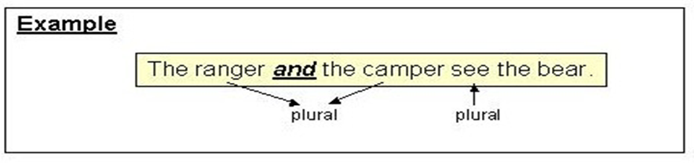
2. When the subject of the sentence is composed of two or more nouns or pronouns connected by and, use a plural verb.
Example: The doctoral student and the committee members ___________ (write/writes) every day.
Example: The percentage of employees who called in sick and the number of employees who left their jobs within 2 years __________ (is/are) reflective of the level of job satisfaction.

Slide 9
3. When there is one subject and more than one verb, the verbs throughout the sentence must agree with the subject. Example: Interviews are one way to collect data and _________ (allow/allows) researchers to gain an in-depth understanding of participants.
Example: An assumption _________ (is/are) something that is generally accepted as true and is an important consideration when conducting a doctoral study.

Slide 10
4. When a phrase comes between the subject and the verb, remember that the verb still agrees with the subject, not the noun or pronoun in the phrase following the subject of the sentence.
Example: The student, as well as the committee members, _________ (is/are) excited.
Example: The student with all the master’s degrees __________ (is/are) very motivated.
Example: Strategies that the teacher uses to encourage classroom participation ___________ (include/includes) using small groups and clarifying expectations.

Slide 11
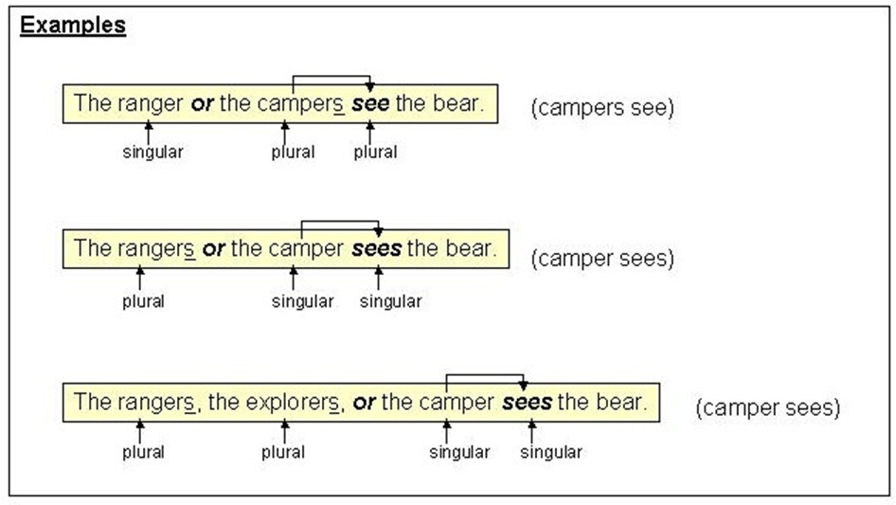
5. If two subjects are joined with correlative conjunctions such as “Either- or” , “ neither-nor” , “not only- but also” etc...then the verb follows the subject that is closer to it.

Slide 12
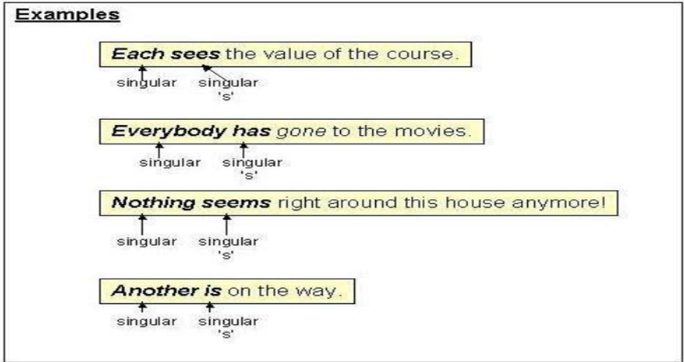
6. The words and phrases "each," "each one," "either," "neither," "everyone," "everybody," "anyone," "anybody," "nobody," "somebody," "someone," and "no one" are singular and require a singular verb.

Slide 13
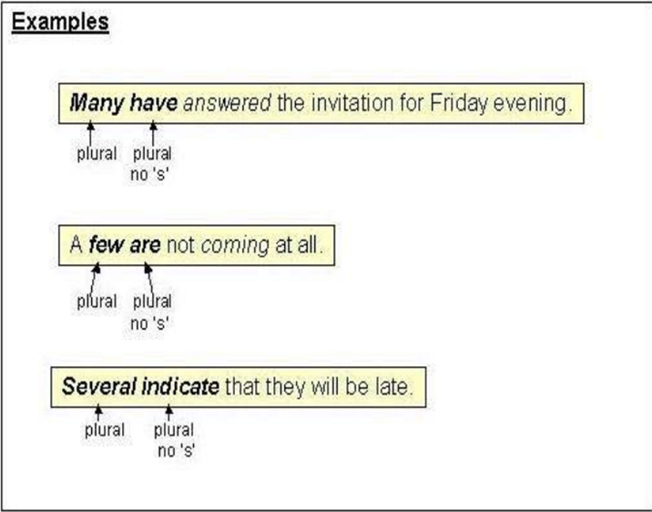
However, the following indefinite pronouns always take plural verbs.

Slide 14
7. Noncountable nouns take a singular verb
Example: Education _________ the key to success.
Example: Diabetes __________ many people around the world.
8. Some countable nouns in English such as earnings, goods, odds, surroundings, proceeds, contents, and valuables only have a plural form and take a plural verb.
Example: The earnings for this quarter ___________ (exceed/exceeds) expectations.
Example: Locally produced goods ___________ (has/have) the advantage of shorter supply chains.

Slide 15
9. In sentences beginning with "there is" or "there are," the subject follows the verb. Since "there" is not the subject, the verb agrees with what follows the verb.
Example: There _____ little administrative support.
Example: There ______ many factors affecting teacher retention.
10. Collective nouns are words that imply more than one person but are considered singular and take a singular verb. Some examples are "group," "team," "committee," "family," and "class."
Example: The group __________ (meet/meets) every week.

Slide 16
Underline the subject (or compound subject) and then identify the verb that agrees with it.
1. Neither the professor nor his assistants (was/were) able to solve the mystery of the eerie glow in the laboratory.
2. Many hours at the driving range (has/have) led us to design golf balls with GPS locators in them.
3. Every year, during the midsummer festival, the smoke of village bonfires (fills/fill) the sky.

Slide 17
4. Your friendship over the years and your support (has/have) meant a great deal to us.
5. Hamilton Family Centre, a shelter for teenage runaways in San Francisco, (offers/offer) a wide variety of services.
6. The story performers (was/were) surrounded by children and adults eager to see magical tales

Slide 18
In the following sentences, underline the subject(s) and the verb(s). If an agreement error exists, correct the error. If there is no error(s), mark the sentence as correct.
1. By taking emphasis off the play instincts of the human race, new vigour and effectiveness is lost because recreation for the body and for the mind is almost non-existent.
2. Rhonda Holmes is one of the scientists’ aides who have been so helpful to the committee staff.

Slide 19
3.This class of students are more intelligent.
4. The principles of science is difficult to understand.
5. There is four thousand students in the university.
6. The student who conducted the research for the last three months have determined that the amount of sales generated will decrease by five percent.
7. The gorilla, along with two monkeys, a kangaroo, and a white bird, were seen on the deck of an old, weathered boat yesterday during a cloud-break.

Slide 20
Underline the subject (or compound subject) and then identify the verb that agrees with it.
1.The samples on the tray in the lab (need/needs) testing.
2. Mary and John usually (plays/play) together.
3. Both of the dogs (has/have) collars.
4. Neither the dogs nor the cat (is/are) very hungry.
5. Either the girls or the boy (walk/walks) in the evening

Slide 21
6. The student, as well as his teacher, (was/were) going on the field trip.
7. The hard tests (comes/come) at the end of the fall.
8. Both of my roommates (has/have) decided to live in the dorms.
9. The student, as well as his teacher, (was/were) going on the field trip.

Slide 22
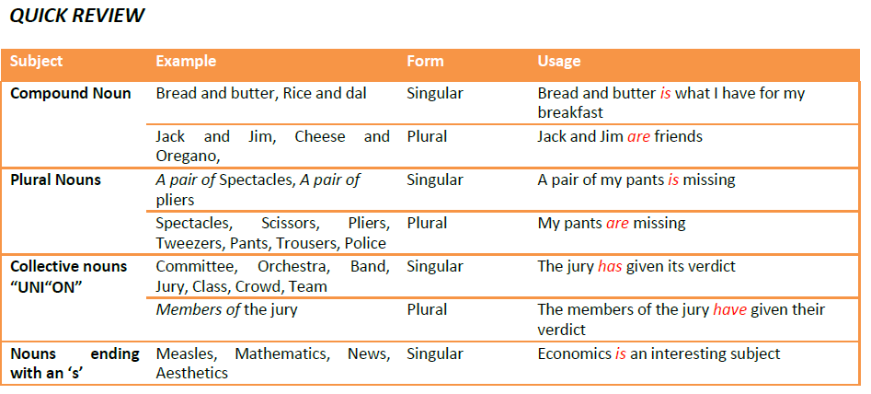

Slide 23
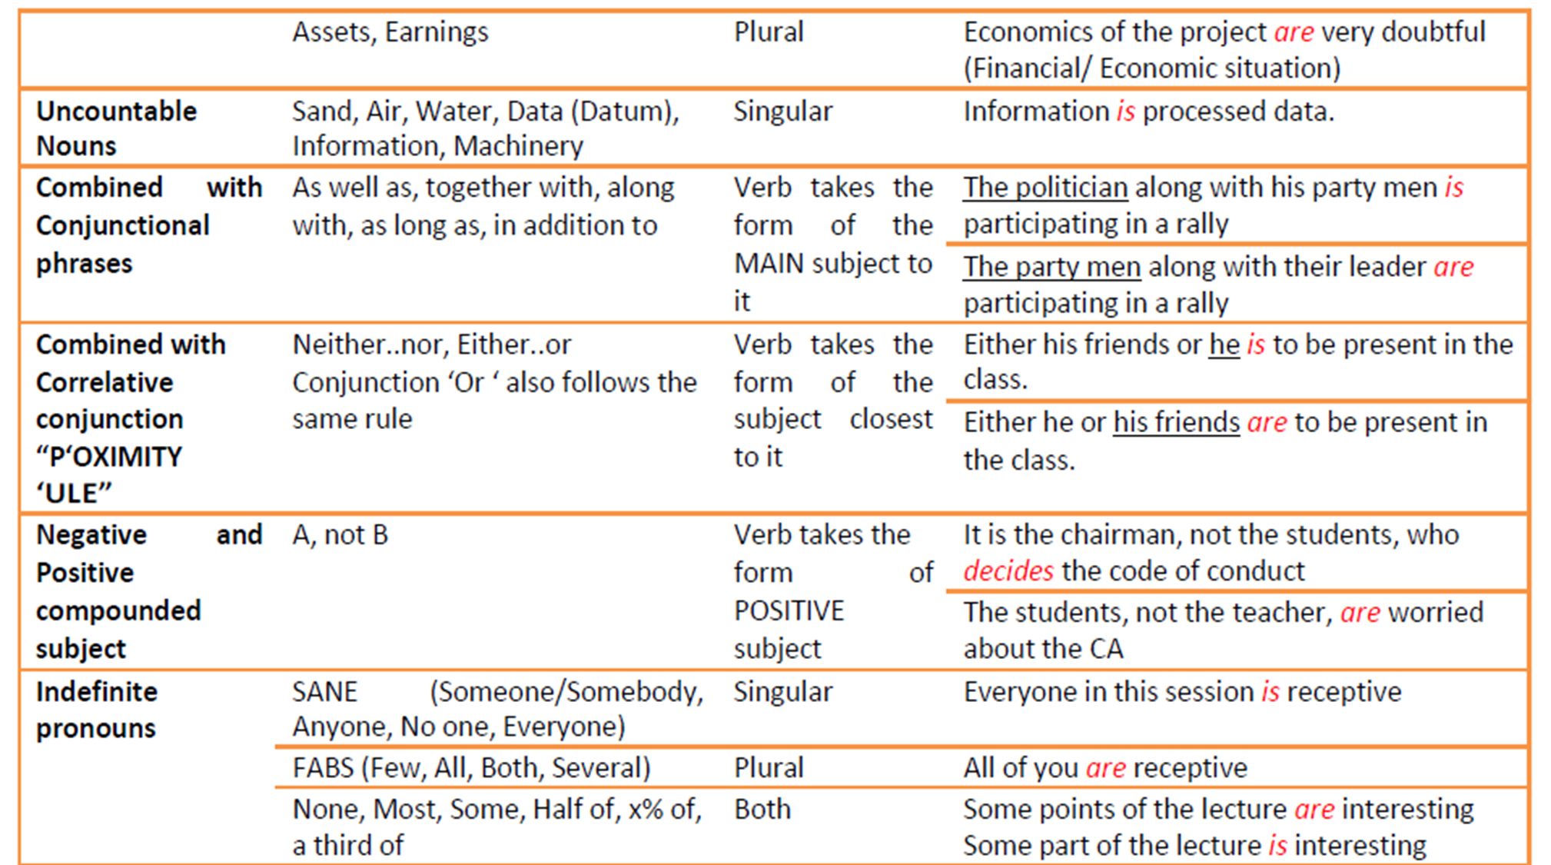

Slide 24
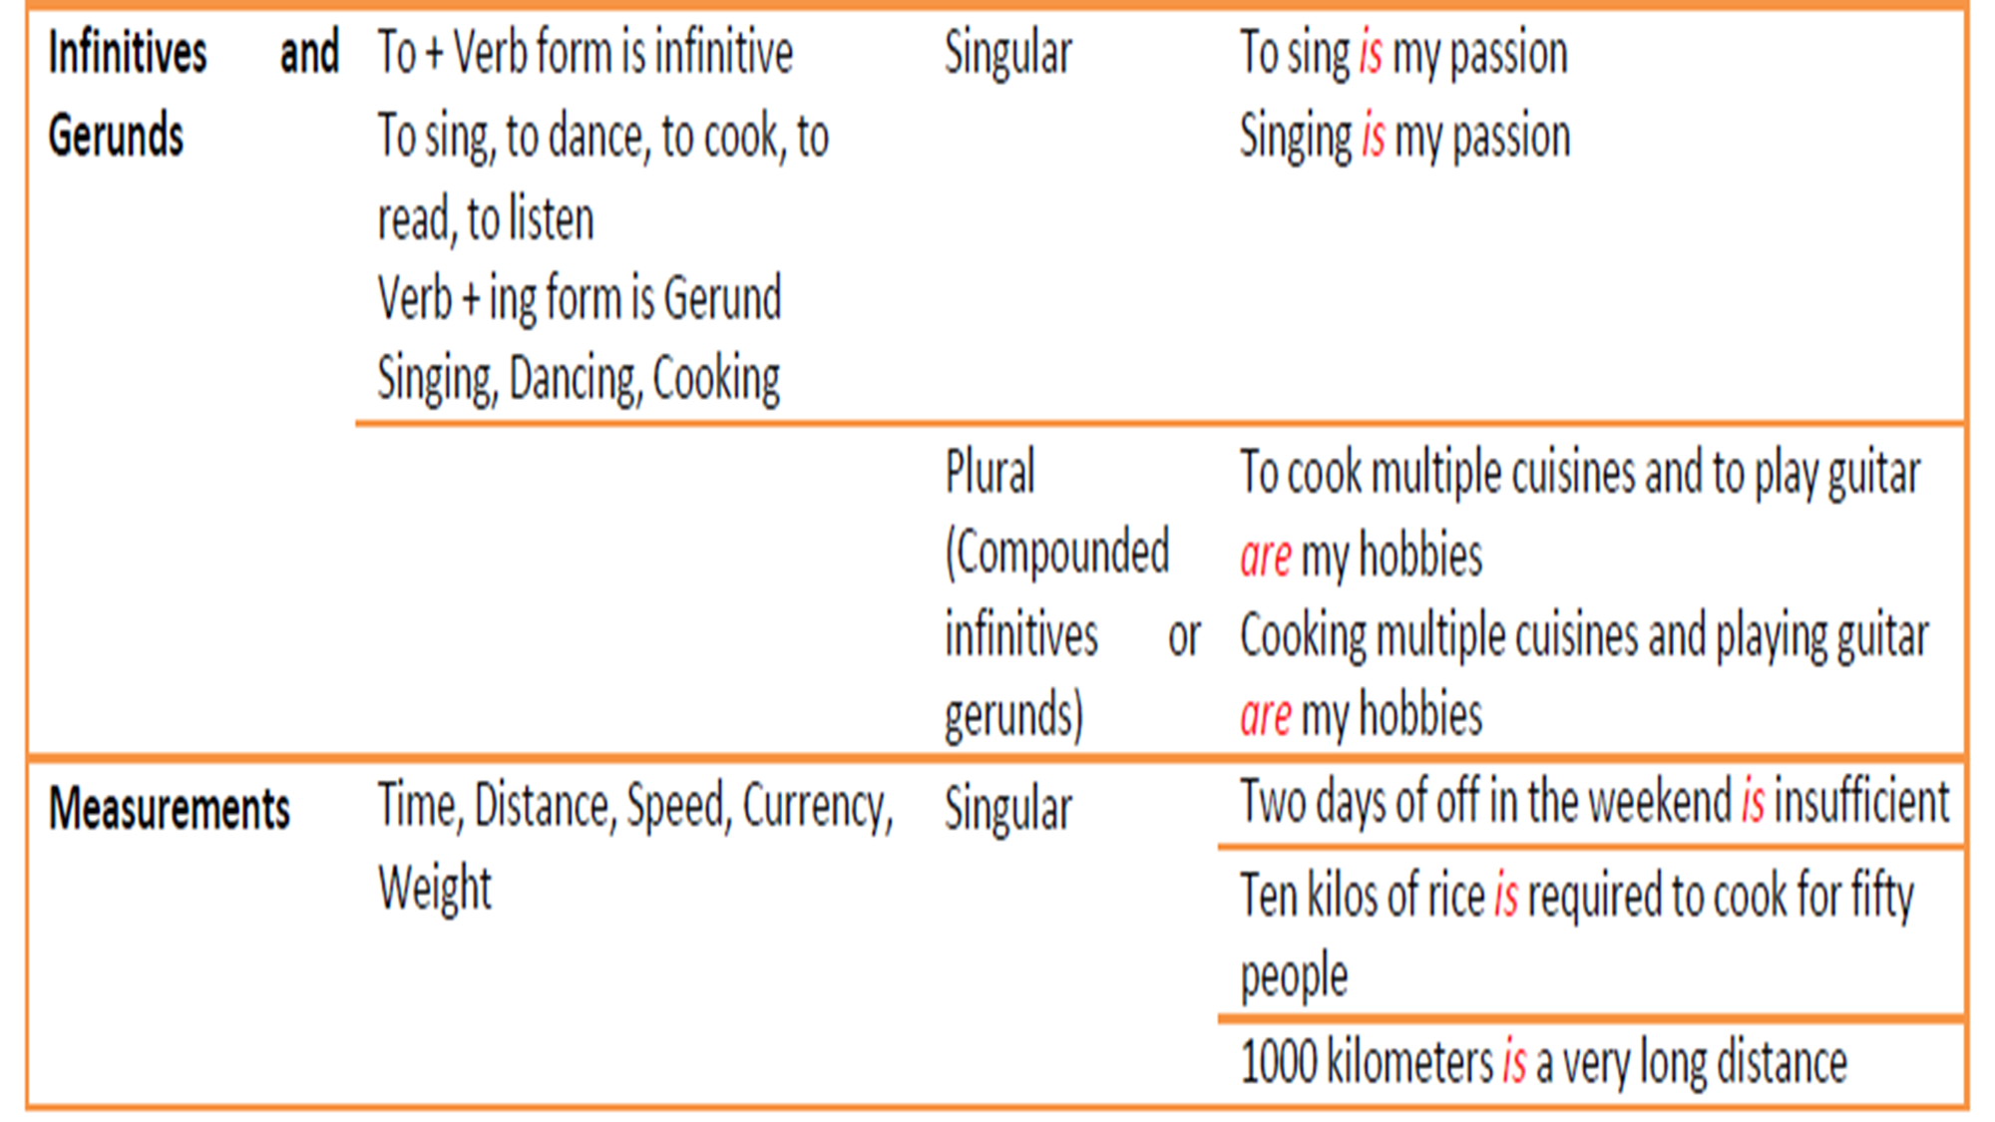

Slide 25
Thank you

